Slide 1
ASP.Net Core –Mapping URLs to methods using conventional routing
Kamal Beydoun
Lebanese University – Faculty of Sciences I
Kamal.beydoun@ul.edu.lb

Slide 2
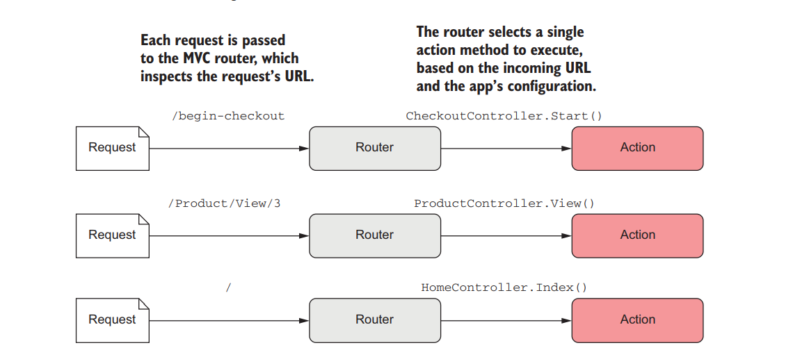
Routing

Slide 3
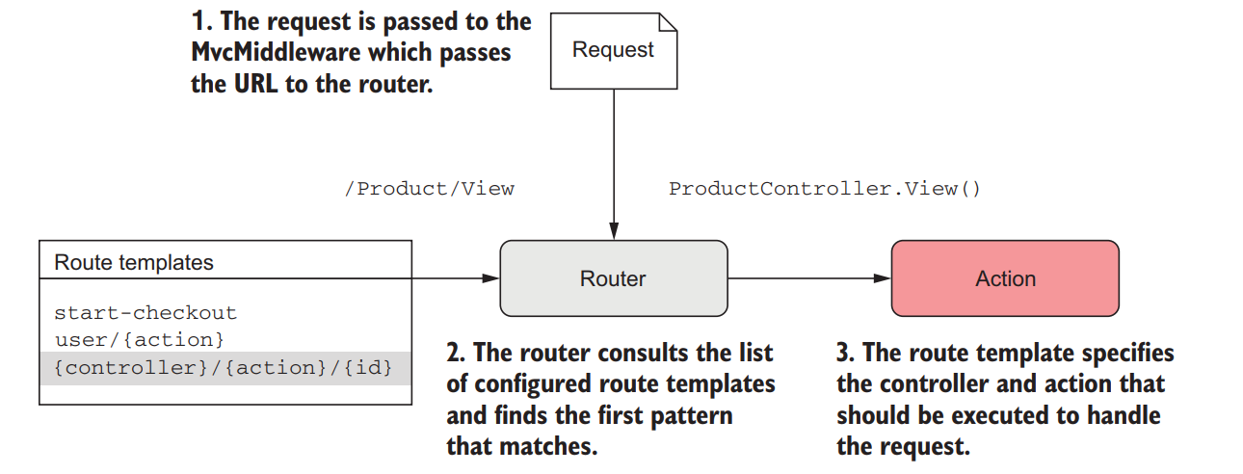
What is routing?
Mapping an incoming HTTP request to a specific handler.
Notes:
In MVC, the handler is an action method.

Slide 4
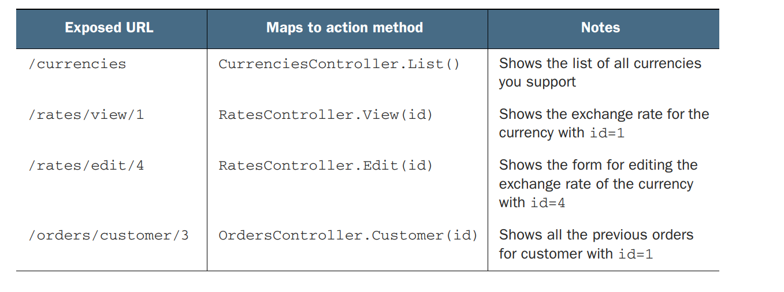
Convention-based routing
This approach is often used when building traditional HTML web applications using MVC, as it makes the structure easy to reason about for users and gives hackable URLs.
Notes:
In this chapter, imagine you’ve been asked to build an online currency converter for a bank. The application will have traditional pages like a homepage and a contact page, but the meat of the website will be a series of pages for viewing the exchange rates of different currencies, and for converting from one exchange rate to the next.
it’s easy to modify your exposed URLs without having to change your controllers and actions at all.

Slide 5
Routing to MVC controllers and actions
Two different ways to define these mappings in the application:
Using global conventional routing for controllers returning HTML
Using attribute routing [Route] for Web API controllers where possible.
Notes:
You can also use attribute-based routes to tie a given URL to a specific action
method by placing [Route] attributes on the action methods themselves. This provides a lot more flexibility as you can explicitly define what a URL for a given action
method should be.

Slide 6
Route templates
Route templates define the structure of known URLs in your application.
Strings with placeholders for variables that can contain optional values and map to controllers and actions.
A single route template can match a number of different URLs.
The route template syntax is powerful and contains many different features that are controlled by splitting a URL into multiple segments.
small contiguous section of a URL.
separated from other URL segments by at least one character, often by the / character.
Notes:
The /product/index
and /product URLs would both be matched by the product/{action=index} route
template, for example, and the /customer/1 and /customer/2 URLs would both be matched by the customer/{id} route template.

Slide 7
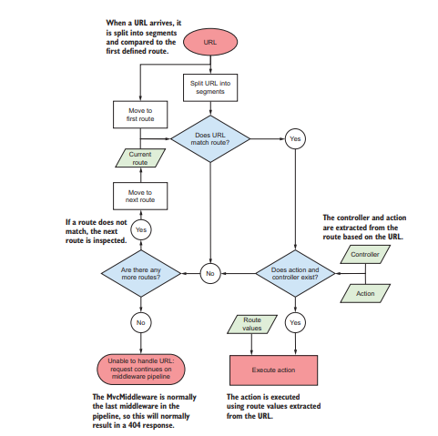
These route templates are global, so you define them in Startup.cs when adding the MvcMiddleware to your pipeline.

Slide 8
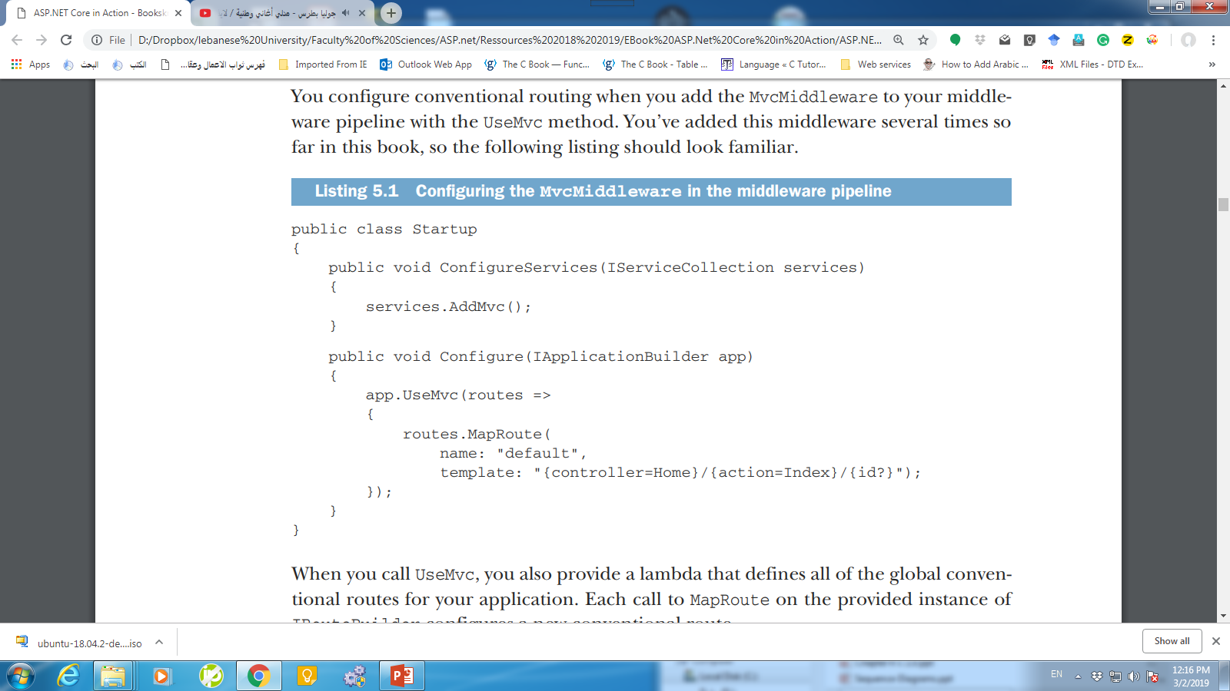
Routing using conventions
Each call to MapRoute on the provided instance of IRouteBuilder configures a new conventional route.
Notes:
The code in UseMVC :
var routes = new RouteBuilder(app);
// Add connection to MVC, will be hooked up by calls to MapRoute.
routes.DefaultHandler = new MvcRouteHandler(...);
// Execute callback to register routes.
// routes.MapRoute("default", "{controller=Home}/{action=Index}/{id?}");
// Create route collection and add the middleware.
app.UseRouter(routes.Build());

Slide 9
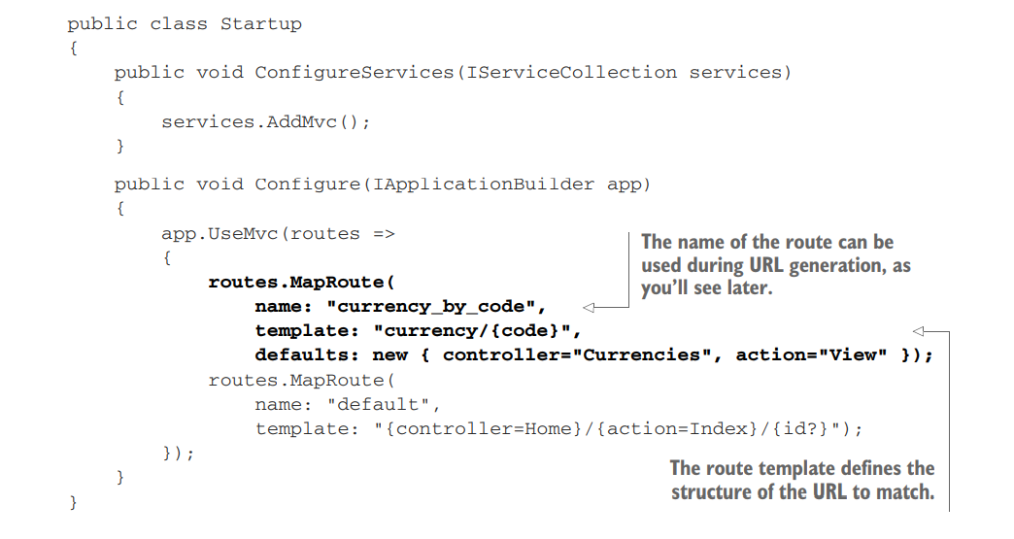
Example
The order in which you add the routes to the IRouteBuilder defines the order against which the routing infrastructure will attempt to match an incoming request.

Slide 10
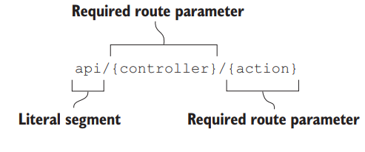
Understanding route templates
The route template has a rich and flexible syntax.
A router parses a route template by splitting it into a number of segments.
A segment is typically separated by the / character, but it can be any valid character.
Each segment is either
A literal value (ignoring case)
A route parameter
Notes:
Route values are the values extracted from a URL based on a given route template. Each route parameter in a template will have an associated route value and is stored as a string pair in a dictionary. They can be used during model binding.
Regular Expression
https://docs.microsoft.com/en-us/aspnet/core/mvc/controllers/routing?view=aspnetcore-2.2#attribute-routing

Slide 11
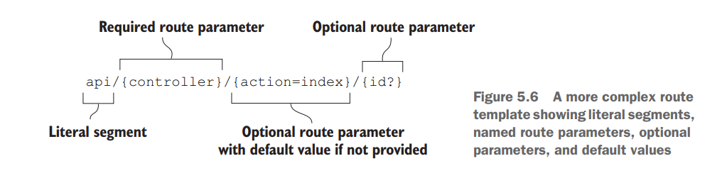
Using optional and default values
Remember that only the {controller} and {action} parameters are obligatory, and that the router uses only these values to decide which action to execute.

Slide 12
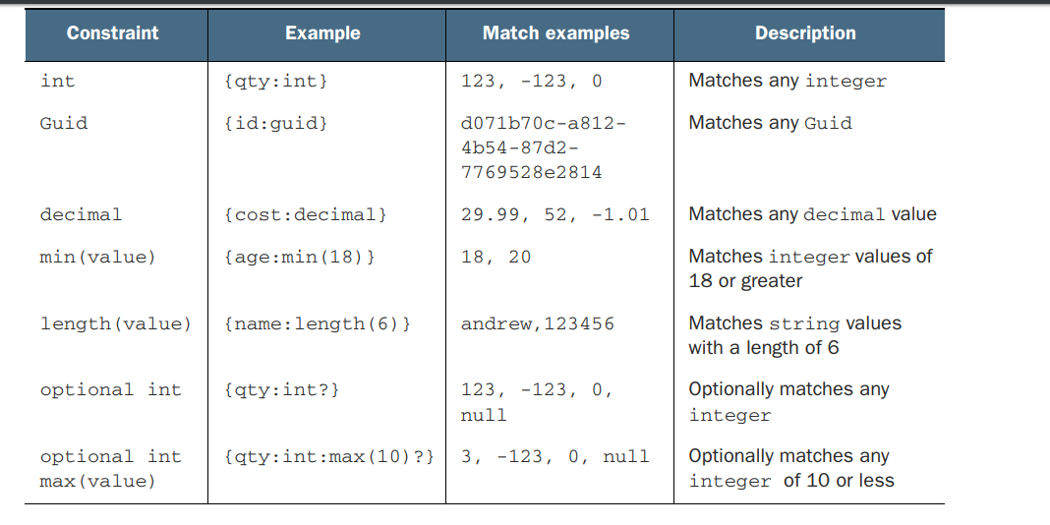
Adding additional constraints to route parameters
Constraints can be defined in a route template for a given route parameter using : (a colon).
Notes:
Constraints can be defined in a route template for a given route parameter using : (a colon). For example, {id:int} would add the IntRouteConstraint to the id parameter. For a given URL to be considered a match, the value assigned to the id route value must be convertible to an integer.
you can find a more complete list online at http://mng.bz/U11Q
GUID (or UUID) is an acronym for 'Globally Unique Identifier' (or 'Universally Unique Identifier'). It is a 128-bit integer number used to identify resources.

Slide 13
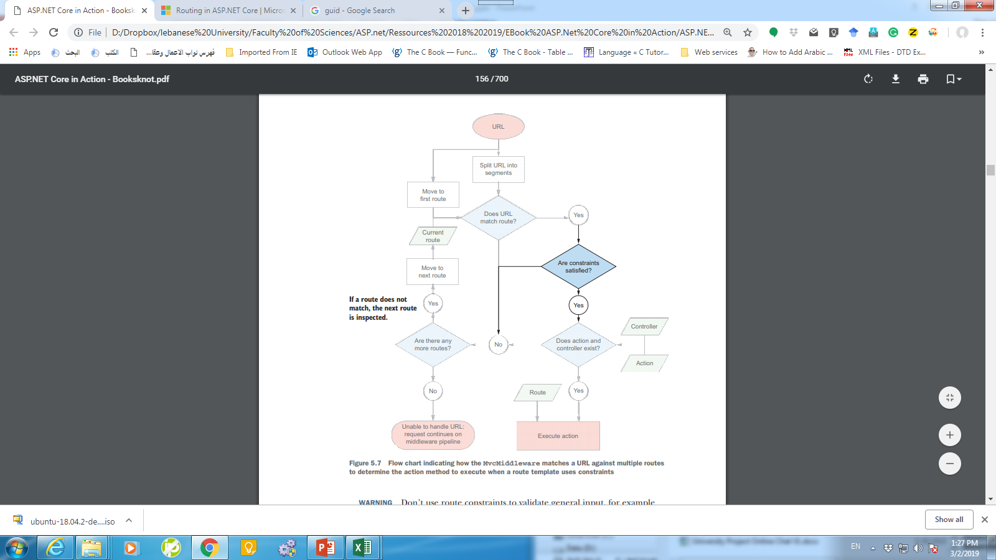
Routing FlowChart

Slide 14
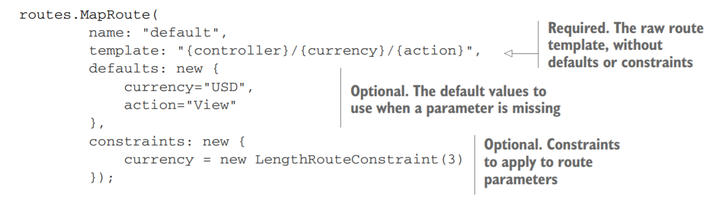
Defining default values and constraints using anonymous objects
routes.MapRoute( name: "default",
template: "{controller}/{currency=USD:length(3)}/{action=view}");

Slide 15
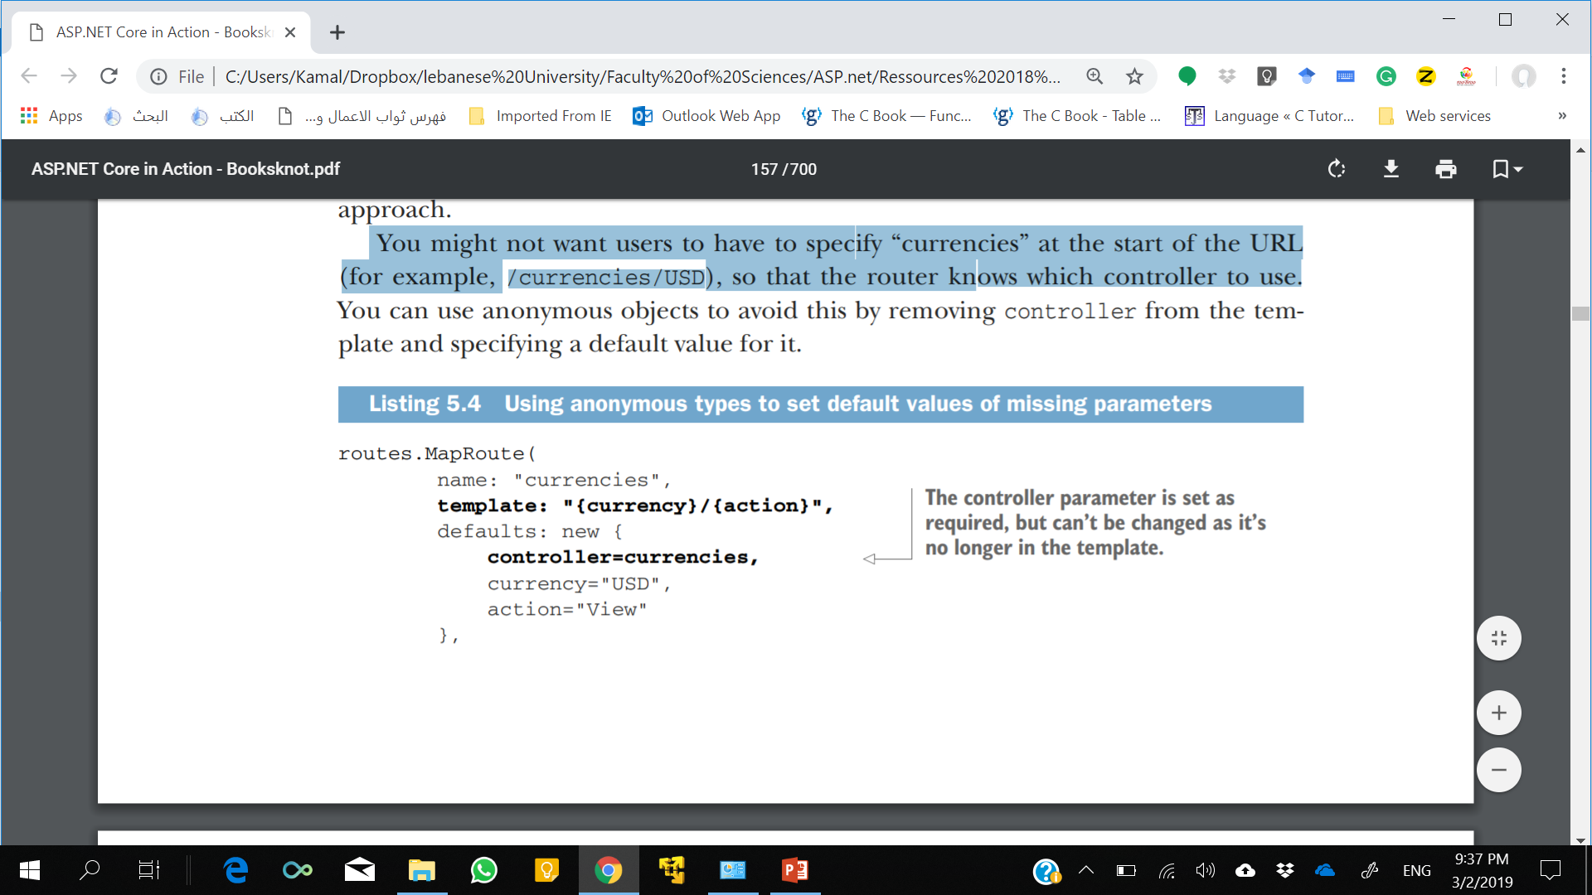
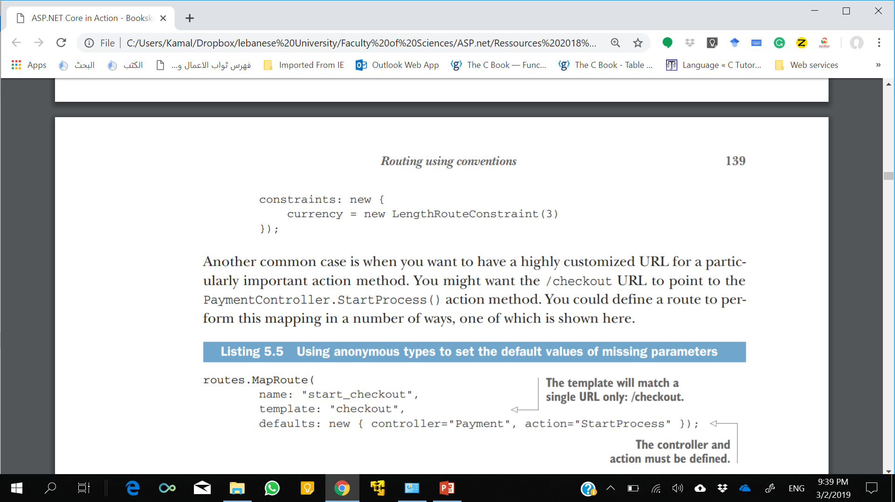
Example
You might not want users to have to specify “currencies” at the start of the URL (for example, /currencies/USD), so that the router knows which controller to use.

Slide 16
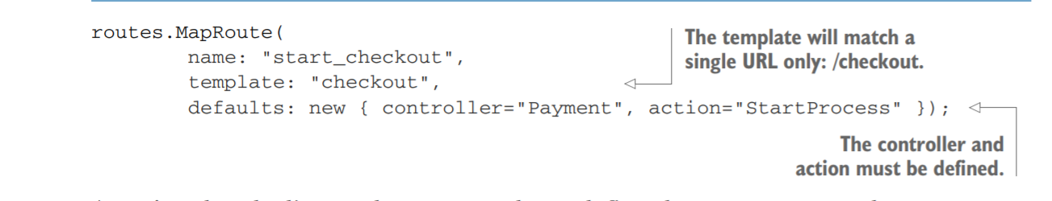
Example
Notes:
As we’ve already discussed, you must always define the controller and action route parameters for a given route, so the middleware can work out which action to execute. By using the defaults anonymous type, you can ensure the route is valid without having to include the name of the controller or the action in your template
definition or URL.

Slide 17
Matching arbitrary URLs with the catch-all parameter
segments normally split around the slash character, /, so the route parameters themselves won’t contain a slash.
What do you do if you need them to, or you don’t know how many segments you’re going to have?
Catch-all parameters can be declared using an asterisk inside the parameter definition, like {*others}
Route values are the values extracted from a URL based on a given route template. Each route parameter in a template will have an associated route value and is stored as a string pair in a dictionary. They can be used during model binding.
Notes:
Route values can be accessed by using the ActionContextAccessor class.
DI Registration
services.AddTransient<IActionContextAccessor, ActionContextAccessor>();
https://docs.microsoft.com/en-us/dotnet/api/microsoft.aspnetcore.mvc.actioncontext?view=aspnetcore-2.0

Slide 18
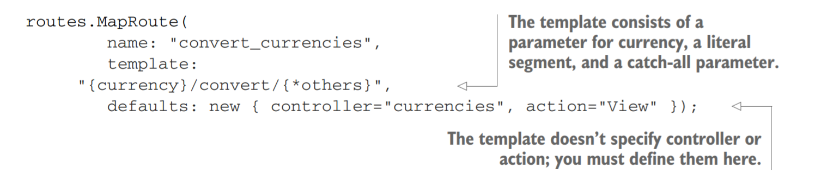
Example
Notes:
In the listing, I’ve specified a fixed literal segment, "convert", so that part of the URL isn’t included in the catch-all title parameter. I’ve used the anonymous type
approach again for specifying the controller and action parameters.
Take particular care when ordering catch-all routes. They will capture the whole unmatched portion of a URL. Counteract greedy routes by defining them later in your Startup.Configure method.
Route values are the values extracted from a URL based on a given route template. Each route parameter in a template will have an associated route value and is stored as a string pair in a dictionary. They can be used during model binding.

Slide 19
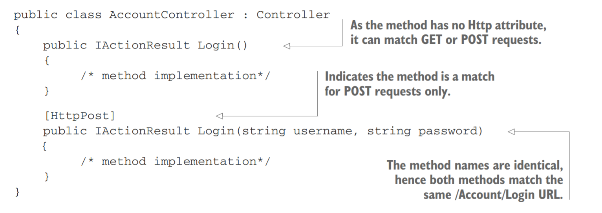
Handling multiple matching actions for a route
the [HttpPost] attribute indicates that the second Login method is a match for POST requests only, and not any other HTTP methods.
Notes:
https://docs.microsoft.com/en-us/aspnet/core/mvc/controllers/routing?view=aspnetcore-2.2#attribute-routing
For the initial GET request, there’s now only one method that’s a match—the first action in the controller—so this action executes to generate the response. The user can then enter their details, press submit, and send a POST request.
Now, both methods can still handle POST requests—the first method can handle any HTTP method and the second method can handle only POST requests.
But an action method with an IActionConstraint attribute “trumps” an action method without one. The second action method “wins” the contest and executes in response to the POST request. All the common HTTP methods, such as GET, POST, PUT, and DELETE, have IActionContraint HTTP methods.
Use types of IActionConstraint, such as [HttpPost] and [HttpGet], to provide precedence to one action method over another where they would match the same URL.

Slide 20
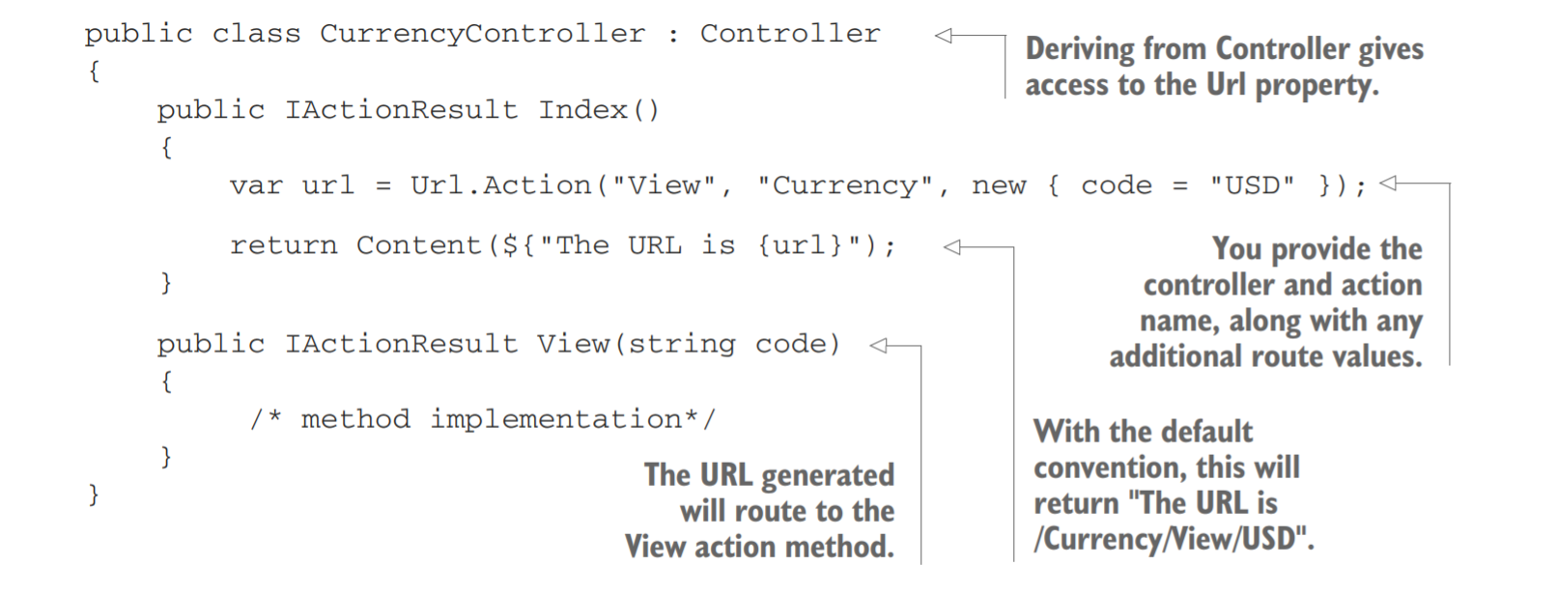
Generating URLs from route parameters
If you rename a controller and you’re using convention-based routing, then the URLs associated with the actions will also change.
Notes:
The Url property is an instance of IUrlHelper that allows you to easily generate URLs for your application by referencing other action methods. It exposes an Action method to which you pass the name of the action method, the name of the controller, and any additional route data. The helper will then generate a URL based on the collection of registered conventional routes.

Slide 21
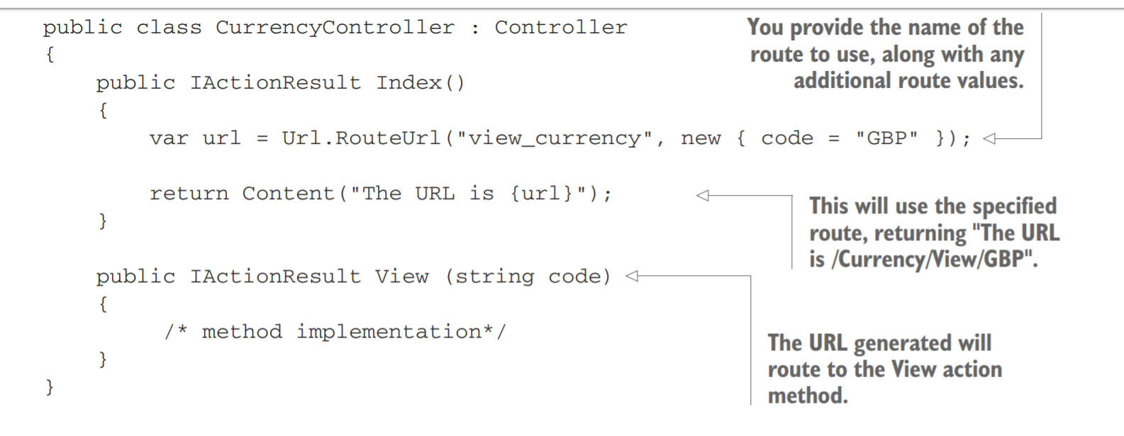
Generating URLs based on a route name

Slide 22
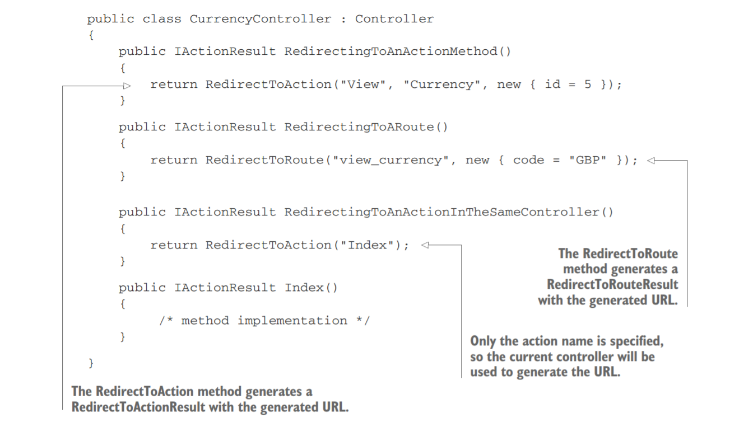
Generating URLs with ActionResults
Notes:
Listing 5.13 shows two ways to generate URLs from an ActionResult. The RedirectToAction method takes in action and controller names, as well as route
parameters, and generates a URL in the same way as the Url.Action method. Similarly, the RedirectToRoute is equivalent to Url.RouteUrl.

Slide 23
Summary
Routing is the process of mapping an incoming request URL to an action method that will execute to generate a response.
Route templates define the structure of known URLs in your application. They’re strings with placeholders for variables that can contain optional values and map to controllers and actions.
Routes can be defined either globally using conventional routing or can be mapped explicitly to an action using attribute routing.
An application can have many different routes. The router will attempt to find the first route where the route template matches the incoming URL.
It’s important to consider the order of your conventional routes. You should list the most specific routes first, in order of decreasing specificity, until you get to the most broad/general route

Slide 24
Summary
Route parameters are variable values extracted from a request’s URL.
Route parameters can be optional and can have default values used when they’re missing.
Route parameters can have constraints that restrict the possible values allowed. If a route parameter doesn’t match its constraints, the route isn’t considered a match.
The controller and action route values must be able to be calculated for every route template. They can either be matched from the URL or using default values.
Don’t use route constraints as general input validators. Use them to disambiguate between two similar routes.
Use a catch-all parameter to capture the remainder of a URL into a route value.
The [HttpPost] and [HttpGet] attributes allow choosing between actions based on the request’s HTTP method when two actions correspond to the same URL.
You can use the routing infrastructure to generate internal URLs for your application.
The IUrlHelper can be used to generate URLs as a string based on an action name or on the name of a specific route.
You can use the RedirectToAction and RedirectToRoute methods to generate URLs while also generating a redirect response

